Slide 1
Car Speed Estimation using Contextual Convolutions
Astha Gupta ag7982
Varun Menon vk2148
Utkarsh Kumar uk2012
Notes:
Hi everyone, I am Astha and my team members are Varun and Utkarsh, I am here to present our work on Car Speed Estimation using Contextual Convolutions.

Slide 2
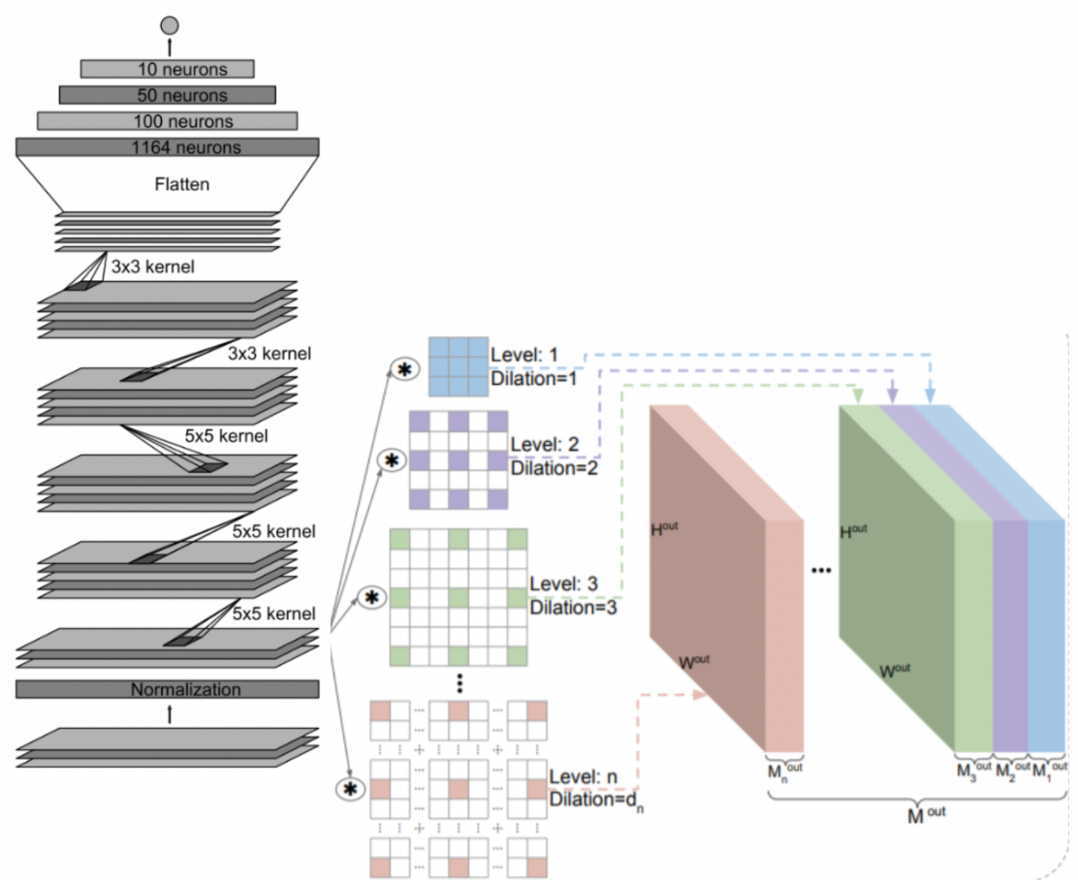
Baseline Model
CoConv
Task
Estimate the speed of a moving vehicle using dash camera feed.
Dataset
Video consisting of 20800 frames taken at 20 fps. Split into train and validation set (80:20), Courtesy Comma.AI
Methodology
Use of Gunnar Farneback method for optical flow computation.
Used Contextual Convolutions as the neural architecture.
Nvidia’s ‘End-to-End Learning for Self-driving Cars’ used as baseline model.
Loss used: MSE
Notes:
Our task is to estimate the speed of a moving vehicle based on the video feed from a dashcam. For this task, we used Comma.Ai’s Speed Challenge dataset which is a video consisting of 20800 frames and is shot at 20 frames per second. The final output would therefore be, the speed for each frame.
As for the approach, we convert the video frames into optical flow. And this is used as the input for the CNN. The CNN performs a regression task to estimate the speed of the vehicle. We use MSe as our loss metric.
For the baseline CNN model, we used Nvidia’s End-toEnd Driving Car CNN architecture. As shown in the figure, the left portion shows the baseline CNN model.
In our proposed method, we use Contextual Convolutions. Each convolution layer now, is split into sets of kernels which have different dilation rates, as shown in the right side of the figure. Each successive dilation rate is responsible for a larger receptive field than the previous one. This adds more contextual informatio to each layer. The outputs of all dilations at each convolution layer are concatenated to create the input for the next layer. Since we use dilated convolutions, we get the advantage of a lerger receptive field while preserving the number of parameters and model size. For the best model we report, the filters in each convolution layer is split equally into different dilation levels,

Slide 3
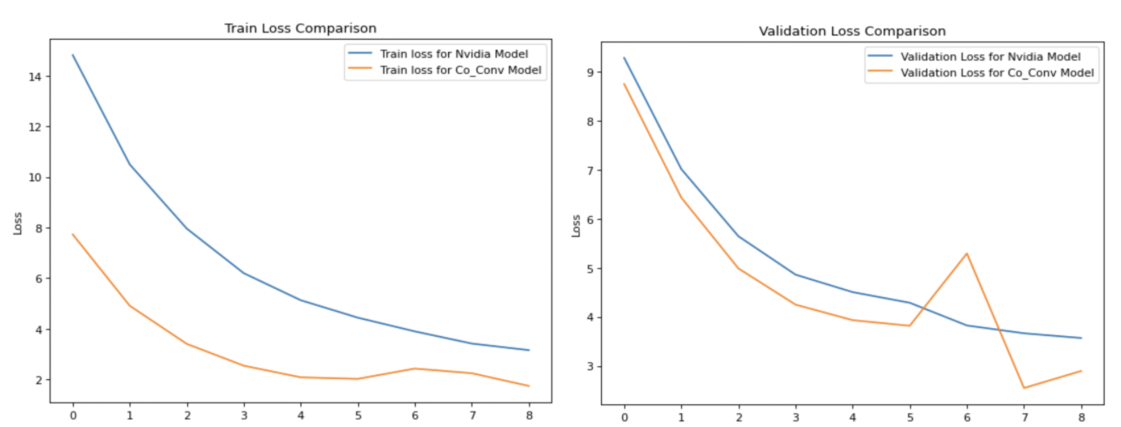
Notes:
We have plotted the results of the training and validation for the baseline model and the coconv model. As we can see, the CoConv Model performs better than the baseline model.

Slide 4
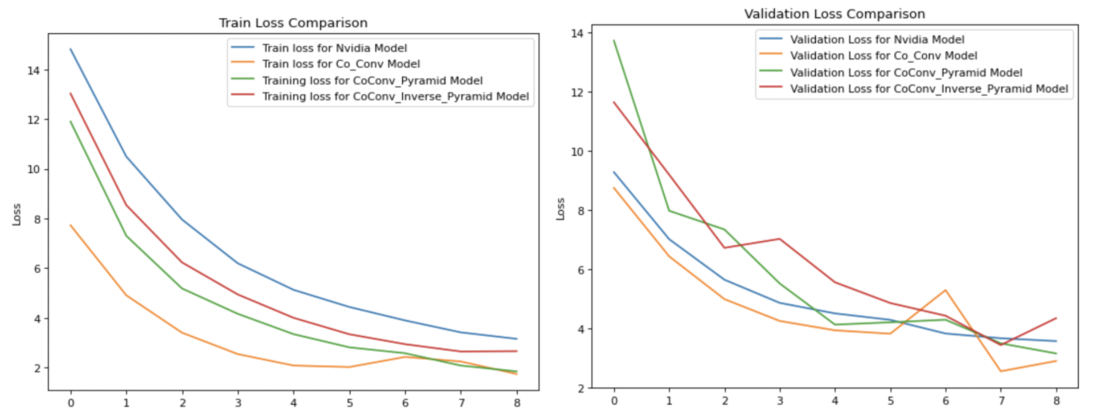
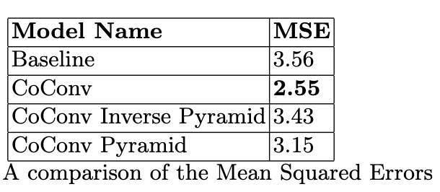
Notes:
To justify the equal split of kernels in our best model, we performed an ablation study showing the performance of contextual models with different importance for each dilation rate. The best model is the CoConv model. In the Pyramid CoCOnv, we weigh the lower level dilations less than the higher level dilations.Conversely, in the Inverse Pyramid model, we assign higher weight to the lower level dilations. The results show that CoConv model with equal split performs better than weighted splits.Overall, contextual variants perform better than the

